Slide 1



Cloud Computing
Abdul Wasay Bin Hassaan
24-SET-35

Slide 2
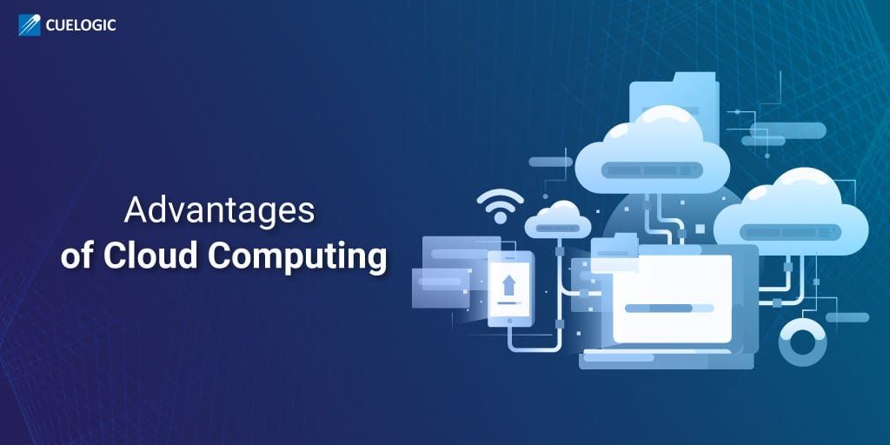
Definition
Types
Key Features
Service Models
Benefits
Use Cases

Slide 3
Definition
Cloud Computing is a way to provide computing resources over the internet, allowing users to pay only for what they use. Rather than having to buy and manage physical hardware or data centers, users can access resources such as servers, storage, databases, networking, software, and more through cloud service providers.

Slide 4
Key Features
On-Demand Self-Service: Users can easily provision resources such as computing power, storage, or applications without requiring direct human assistance.
Broad Network Access: Services are available over the internet, accessible from any location and on a variety of devices.
Resource Pooling: Resources are combined to serve multiple customers, with data and services allocated dynamically based on demand.
Scalability: Resources can be scaled up or down flexibly to align with the workload.
Pay-as-You-Go: Users are charged only for what they utilize, which helps to minimize upfront expenses.

Slide 5
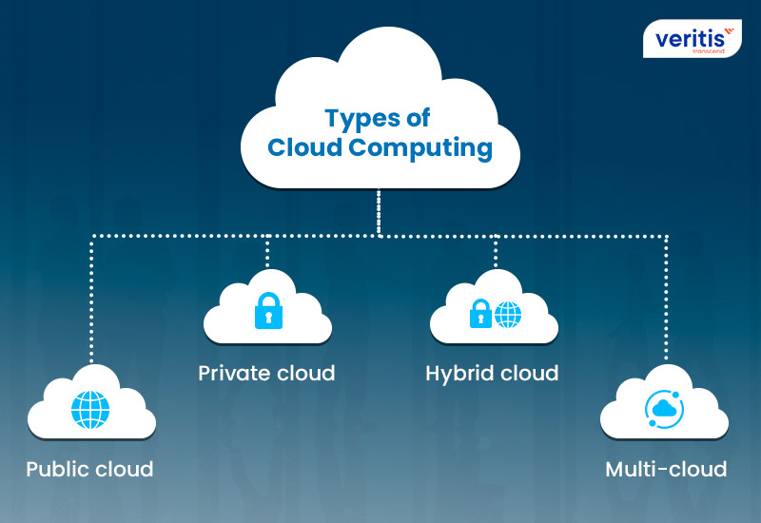
Types of Cloud Computing
Public Cloud: Services are delivered via the internet to various organizations.
Example: AWS,
Microsoft Azure, Google Cloud Platform.
Private Cloud: Dedicated to a single organization, offering greater control and privacy.It can be hosted on-site or by a third-party provider.
Multi-Cloud: Utilizes multiple cloud services from different providers to prevent vendor lock-in and enhance reliability.
Hybrid Cloud: Merges public and private clouds, enabling data and applications to transfer between them.

Slide 6
Service Models
Infrastructure as a Service (IaaS): Offers virtualized computing resources such as servers, storage, and networking.
Examples include Amazon EC2 and Google Compute Engine.
Platform as a Service (PaaS): Provides a platform that allows developers to build, test, and deploy applications without the need to manage the underlying infrastructure.
Examples are Google App Engine and Microsoft Azure App Service.
Software as a Service (SaaS): Delivers software applications via the internet.
Examples include Google Workspace and Salesforce.

Slide 7
Cloud Computing Timeline
1961: John McCarthy introduces the idea of computing as a utility at MIT.
1969: The creation of ARPANET lays the groundwork for network-based computing.
1970: IBM's VM technology leads the way in virtualization, allowing multiple users on a single system.
1977: The first utility computing services start to appear through centralized timesharing.
1983: Internet protocols (TCP/IP) are standardized, making global network computing possible.
1989: The founder of Salesforce suggests delivering software over the internet, planting the seeds for SaaS.
1993: The phrase "cloud computing" emerges in conversations about IT resource abstraction.
1999: Salesforce.com launches, offering one of the earliest SaaS applications.
2002: Amazon Web Services (AWS) is introduced, providing cloud-based computing and storage solutions.

Slide 8
Cloud Computing Timeline:
2006: AWS rolls out EC2, making scalable cloud infrastructure services popular.
2008: Google App Engine is launched, broadening cloud platforms available to developers.
2010: OpenStack and Microsoft Azure establish strong open-source and enterprise cloud options.
2011: Apple iCloud introduces cloud storage to everyday consumers.
2014: Google’s Kubernetes transforms container orchestration for cloud deployments.
2016: Cloud adoption accelerates, with hybrid cloud strategies becoming standard practice.
2020: The COVID-19 pandemic speeds up remote work, making cloud computing essential for business operations.
2023: Generative AI increases the demand for high-performance computing on cloud platforms.

Slide 9
Reliability: Offers high availability, disaster recovery, and automatic updates.
Benefits:
Cost-Efficiency: Reduces capital expenses by eliminating the need for physical hardware and infrastructure.
Flexibility: Supports remote work and collaboration by enabling access to resources from anywhere.
Reliability: Offers high availability, disaster recovery, and automatic updates.
Security: Providers often implement advanced security measures and compliance standards.

Slide 10
Uses
Web Hosting: Offering services for hosting websites and applications.
Data Storage and Backup: Safely storing and accessing data.
Big Data Analytics: Analyzing large datasets to gain insights.
AI and Machine Learning: Supplying resources for training and deploying models.
IoT Applications: Overseeing and analyzing data from IoT devices.

